Slide 1
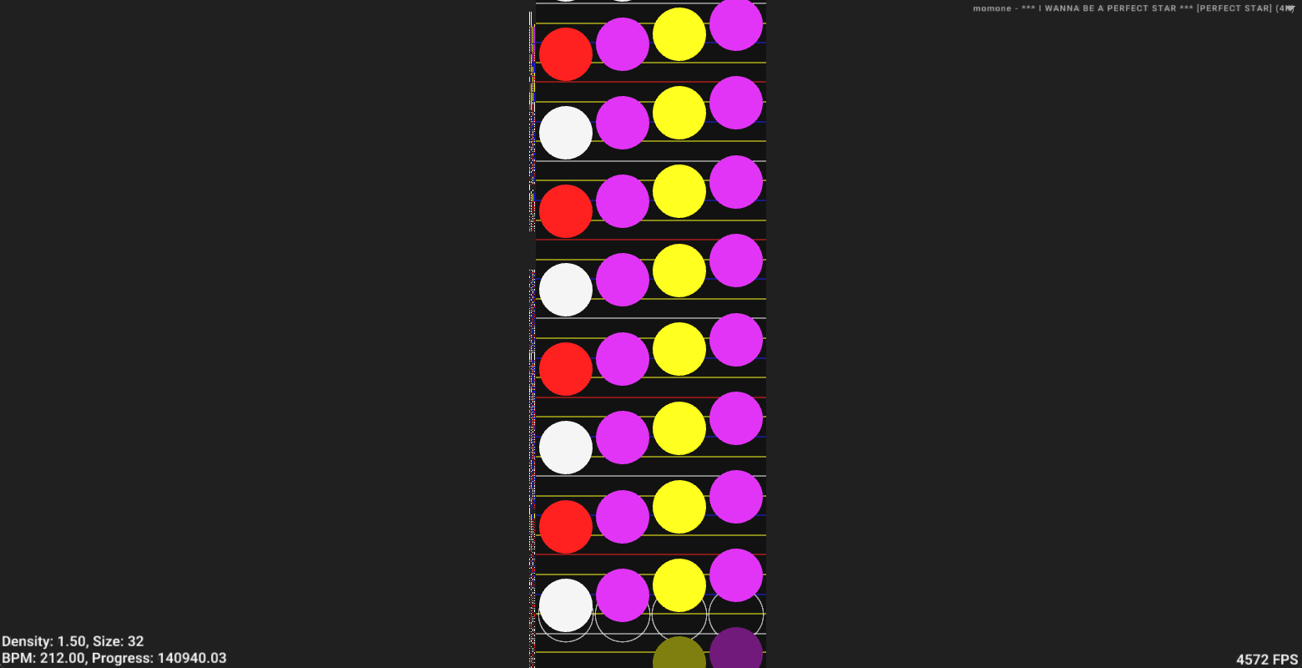

Chartview
A Fast VSRG chart viewer made in Go
by Oliver Pitkänen

Slide 2

So… what is a VSRG?
VSRG stands for:
Vertically
Scrolling
Rhythm
Game
Requirements:
1. Is a rhythm game
2. Scrolls vertically either up or down
bad quality image ;(

Slide 3
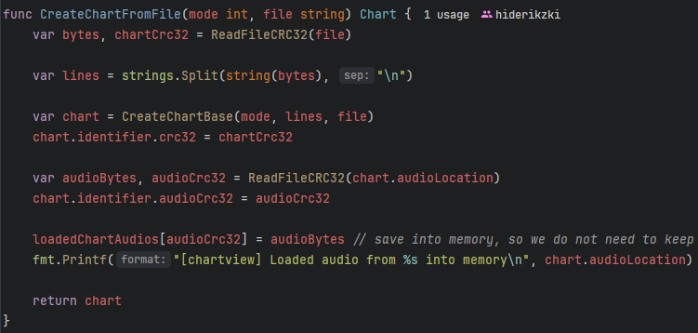
How does Chartview work?
Importing
Reads in a chart file(s) dropped into the application window, and unpacks it if necessary
Reads the associated audio file(s) into memory
Converts the chart(s) to a common manageable format
Displays the chart on screen, and allows switching between loaded ones through a dropdown
Exporting
Takes the imported common format and writes it into a specified text or packed format
Writes the audio from memory to a file
If packing is required, it will pack it into a compressed chart file
Haven’t implemented yet ;(

Slide 4
Example use cases
Viewing most common chart formats in a single application instead of needing a different one for each of them
Converting a chart to a different format for games that do not support the original format
Easily view if any notes in the chart are not snapped to the correct beat

Slide 5
Golang gopher: https://tremaineeto.medium.com/who-first-created-and-drew-the-golang-gopher-bc25149acdc2
Man thinking: https://www.freepik.com/free-photo/pensive-customer-thinking-special-offer_6628809.htm#fromView=keyword&page=1&position=3&uuid=19184425-b671-46a9-8d85-2db38000211f&query=Man+Thinking
VSRG gif: https://tenor.com/en-GB/view/m-tsung-osu-mania-gif-20318667

